Slide 1
City of Oneida
Citywide
Reassessment

Slide 2
What is a Citywide reassessment?
During a reassessment, ALL properties in a municipality will be reviewed
Reassessment does not mean all assessments will increase or even change.
Based on the real estate market, it will be determined which assessments will be increased or decreased
Reassessments DO NOT increase the amount of taxes that need to be collected (tax levy)
The property tax levy is determined separately from the assessments, then distributed over taxable assessments.

Slide 3
Why?
New York State recommends reassessments to be done every 4-6 years; due to market changes; to keep up with fair market values
The longer since the last reassessment the more likely it is that some taxpayers are paying more or less than their fair share of the tax burden
The last reassessment was done in 2007

Slide 4
Current Taxable Values
Eq. Rate: 71%
Taxable AV (tentative): $488,158,591
Taxable AV if at 100% ER (tentative): $692,000,000
Increase taxable AV (tentative): $203,841,409
* Some assessments will go up/ some down; exact numbers would be different, but this is the easiest way to see how under assessed the City is

Slide 5
Potential Cost
Approx. Cost $350,000 +
Approx 1 year to complete
* Possible Inclusions: public relations- helpline, web videos, printed & electronic information; updated photos, informal review & grievance day support, inventory & data collection

Slide 6
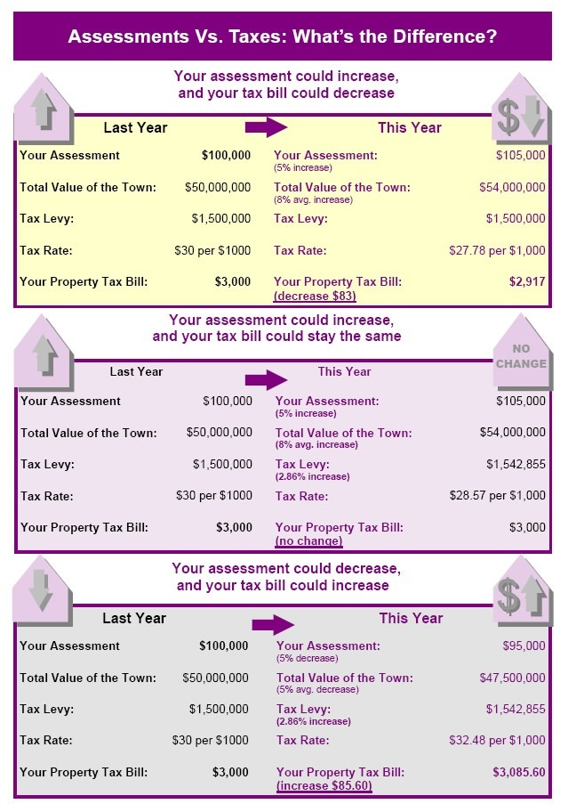
Assessments vs. Taxes
Examples of assessment changes and taxes

Slide 7
Additional Information
https://www.tax.ny.gov/research/property/assess/reassess.htm
Pamphlets and Handouts available by request at the Assessor’s office

Slide 8
Q&A
Council questions?

